Slide 1
Final Internship Presentation
Muskan Bhat
Company: Y The Wait

Slide 2


Company
Y The Wait
Headquarters in Rivium Capelle a/d ijssel
Rapidly growing multinational company

Slide 3
About Y The Wait
An extensive platform developed to provide hospitality features to various types of customers
The customers of the company include an app user that uses app to access hospitality services of the business owners registered with Y the wait, and the businesses registered with the company including restaurants, hotels, supermarkets, event halls, etc.
The basic module contains the digital waiter service, delivery/takeaway/reservation, and exclusively for business owners, are the services like point of sales software, staff app, etc.
The are currently active in canada, usa, netherlands, lebanon and india.
Their business model is peer to peer which is two individuals interact to buy sell goods and services directly with each other or produce goods and service together

Slide 4
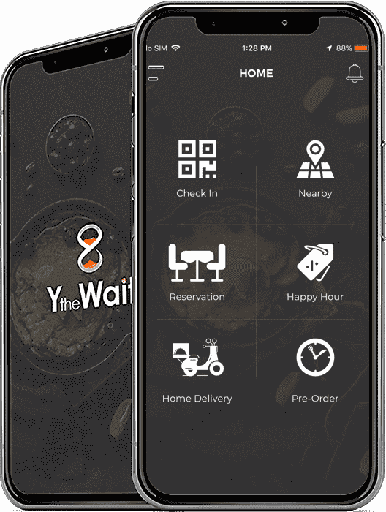
About the product and services of company
The services of Y the Wait are all about evolving hospitality service experience, it serves to eliminate all inconveniences people experience during a restaurant dine-in or a home delivery order.
Their competitors are not any specific firm because no one is right now providing these features or services exactly like them. Some similar firms are, Thuisberzorgd, UberEats or Deliveroo.
The products starting from the app is basically a food ordering app, we can make reservations, take dine in or take away orders. Rest are the tools we provide the merchants to use our services.
Those tools are point of sale, the staff app. The dashboard meanwhile is a web based admin panel used by business owners

Slide 5
Insights and Training Phase
First 2 weeks I focused on my React Js training using resources provided by my supervisor.
Next 2 weeks I spent on my redux training and preparation.
When I began my ordering website assignment, It took me quite a while to get used to bootstrap so my senior colleague/mentor provided me material/guides to bootstrap basics
During the 3rd week of October I got infected with COVID-19, so I had a break of 1 week in my internship.

Slide 6
Workplace environment
Friendly
Open to suggestion and questions
Distance working with the team in India
Communication points
Weekly reports

Slide 7
Phase 1 Assignment Ordering website
This assignment consisted of making the front end of the websites for the merchants based on the different design templates provided which differs based on the business type of the merchants. The websites will be developed in HTML5, CSS, bootstrap, and Java Script.
It is an essential necessity for the businesses registered under Y the wait as these websites are the way website users would be able to view their products or services. The main clients here are the clients of Y The Wait who will avail their services for their businesses.
As every business type has a different kind of ordering website template to choose from, the assignment will be extensive and collaborative. I received the design from our design team, and I had to make the first template. After that it would get check by my senior developer colleague(s) and the website will go live after the backend functionalities are integrated as well.

Slide 8
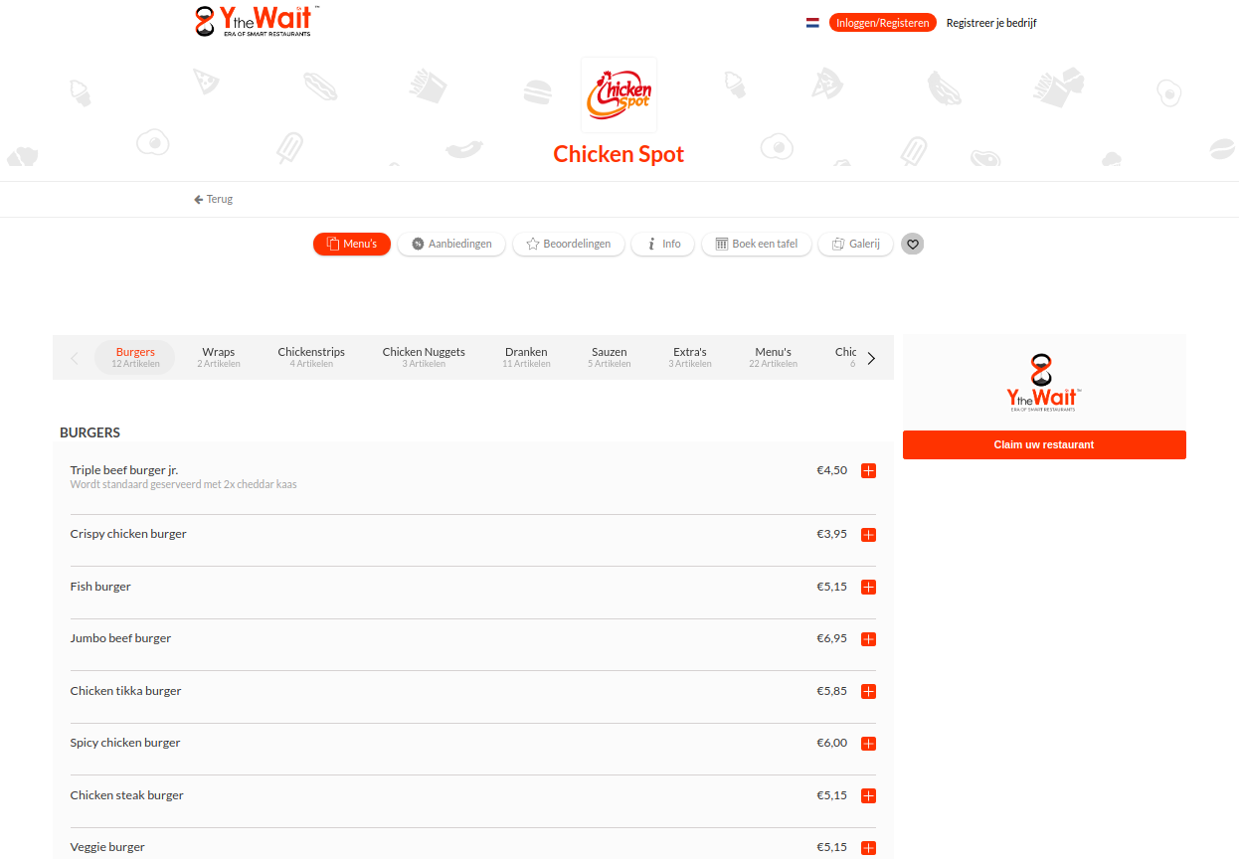
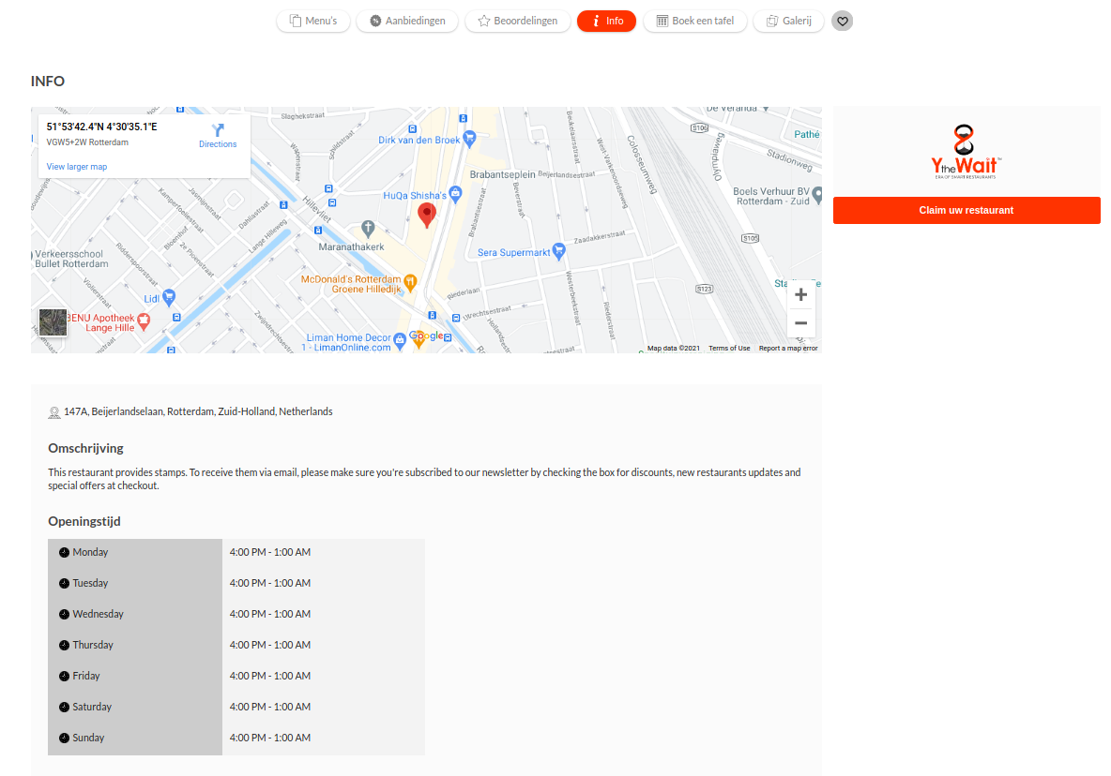
Phase 1 Assignment Ordering website
Current Restaurant ordering website design

Slide 9
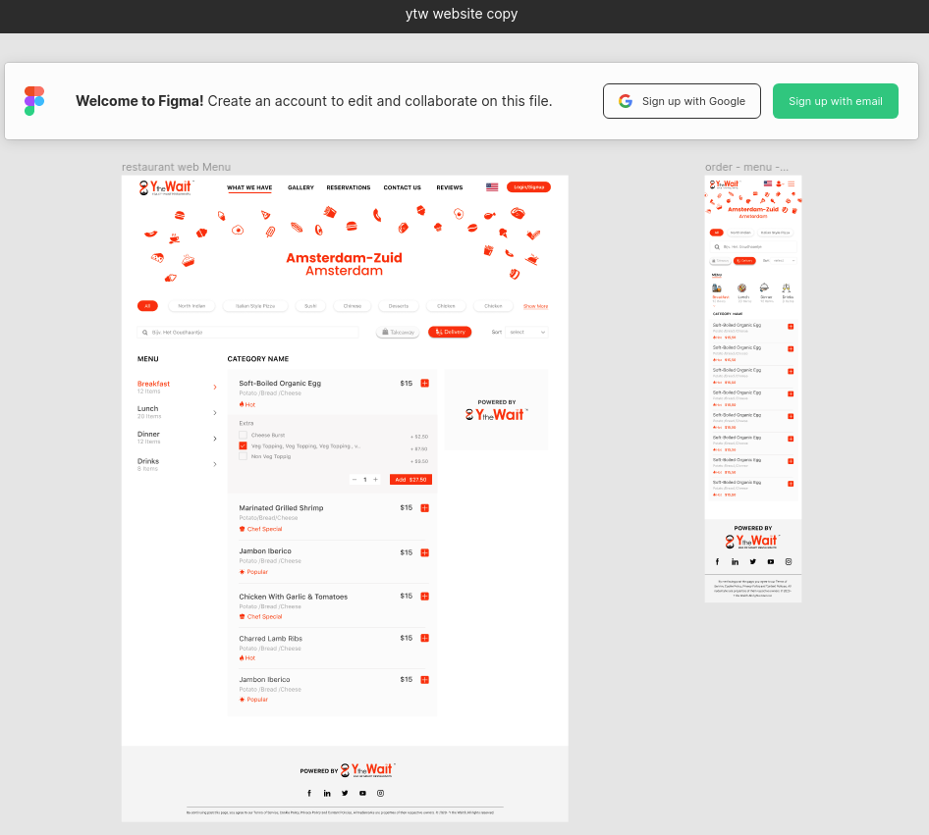
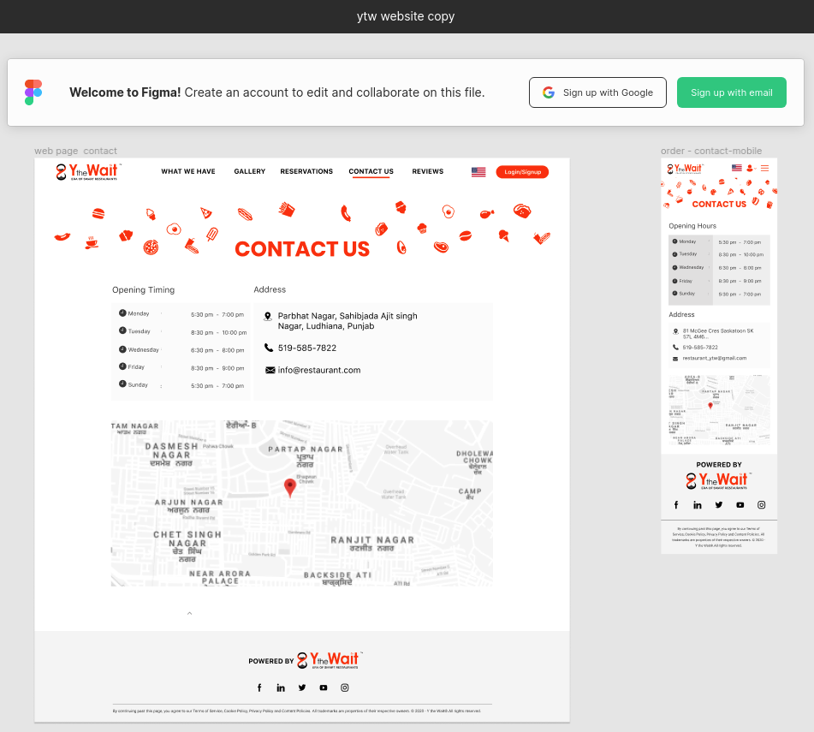
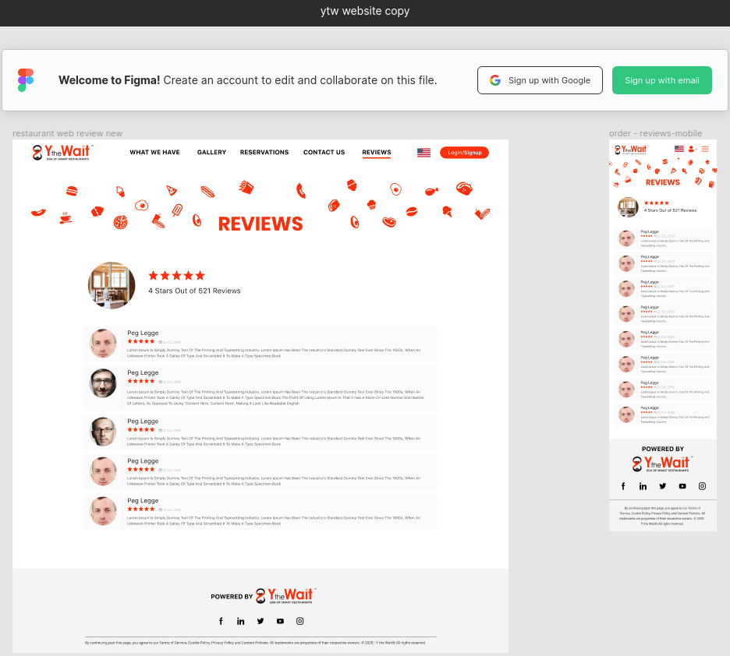
Phase 1 Assignment Ordering website
New restaurant ordering website design provided via design team

Slide 10
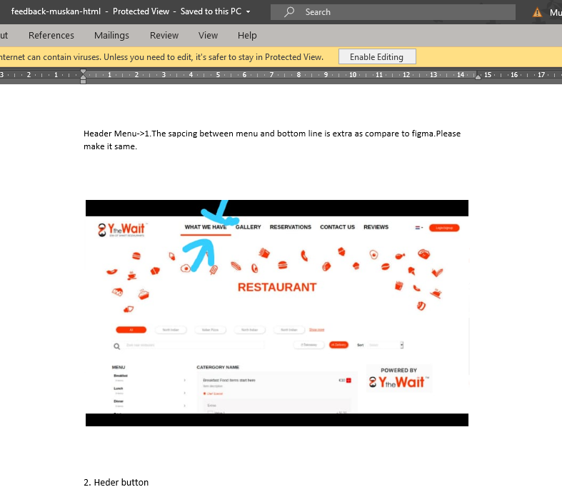
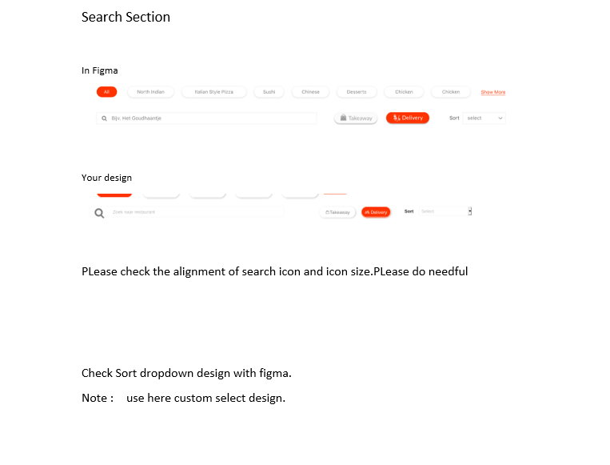
Phase 1 Assignment Ordering website
Feedback method used by senior colleague

Slide 11
Phase 2 Assignment Dashboard – Invoice
I worked on developing a module in the dashboard provided to the business owners which is The Point of sales is used by the business owners to manage their inventory, their menu/products, staff, revenue, reservations, orders, finances/ invoices etc. The module I made was Invoice.
assignment was to rebuild the front end, which is entirely made up of HTML5, jQuery, and bootstrap. The goal was to eliminate jQuery and rely entirely on JavaScript es6 and react with redux.
As Y The wait is a globally growing company it’s reaching more and more customers every day, and this is why advancement of the product was required as the current website design is reportedly slower and primitive and therefor it was decided to re-build the front-end using react which is relatively faster and advanced to support a vast range of customers.
Hence this part of the assignment focuses on improvement of the dashboard for convenience of the future and present clients.
The dashboard modules were made based on the new designs provided by the design team, the task was similar to what I did in phase 1, making the code live based on the design provided but this time in more advanced technologies.

Slide 12
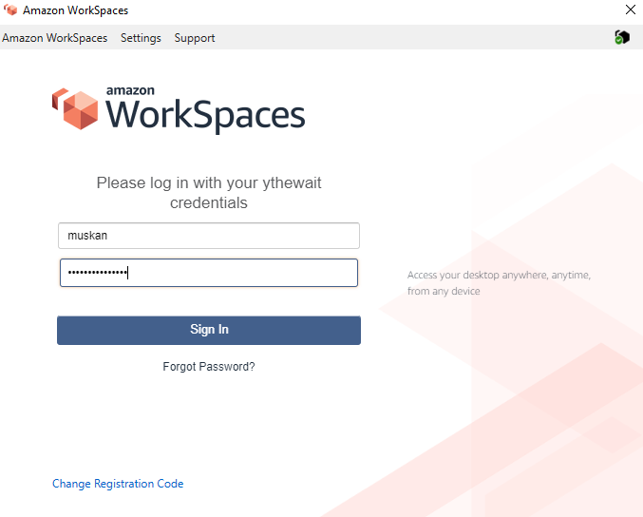
Phase 2 Assignment Dashboard – Invoice
Demonstration to be shown by logging into a virtual machine via screenshare

Slide 13
Reflection
Competencies I have addressed in this internship
Competence Design
Competence Professionalization
Competence Realization

Slide 14
Reflection
It started off smooth with my training and me started to develop my first ordering website based on the design provided to me and after that I got sick and my work came to slight halt but I made up for the lost hours by working extra time.
I did have issues with my internship, the issues started off minor and extended off to a large scale, all because I didn’t communicate with my team about my issues and when I needed help. After my phase 1, I had meeting with my supervisors and my tech development team. After that I worked on my communication and asked more questions and help from my mentors/seniors. My phase 2 went way more smoother than my phase 2 assignment.
Lastly, I enjoyed this experience even though it did not start as the most pleasant one but I learned a lot about how things work in a professional development environment and I would want to work as a front end developer in future as I am interested in it and would like to gain more experience in this field.

Slide 15
Thank you!
Questions ?

